Slide 1
Signal Processing
Tirgul HAZARA

Slide 2
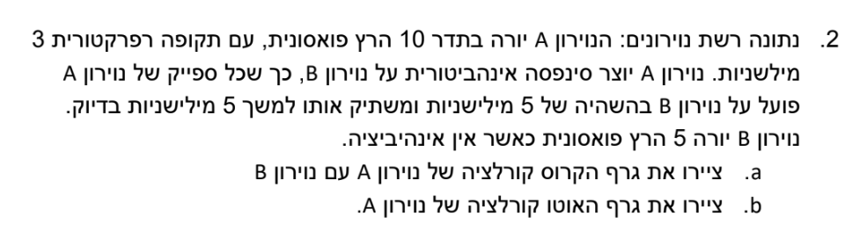
Notes:
just b

Slide 3
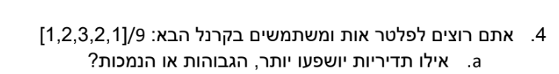

Slide 4
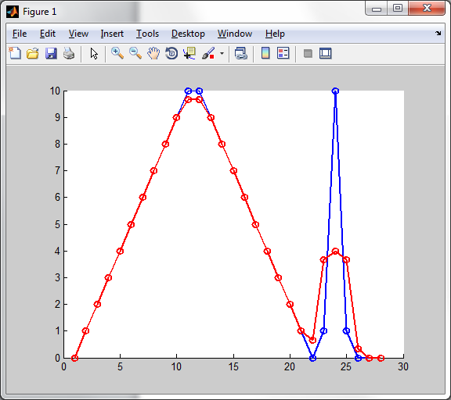
Smoothing is a “low pass filter”
Original signal
Smooth(x,4)

Slide 5
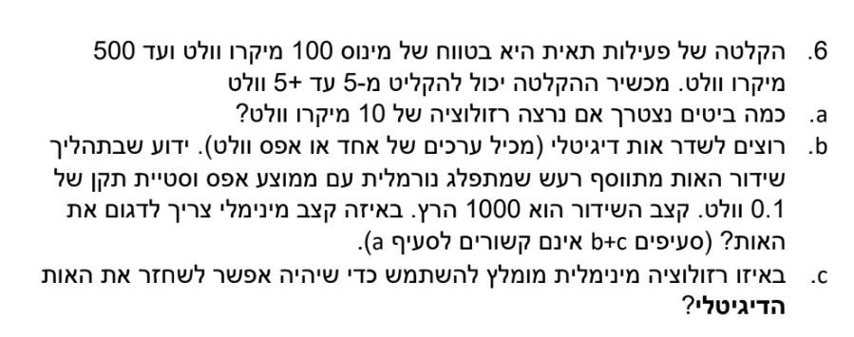

Slide 6
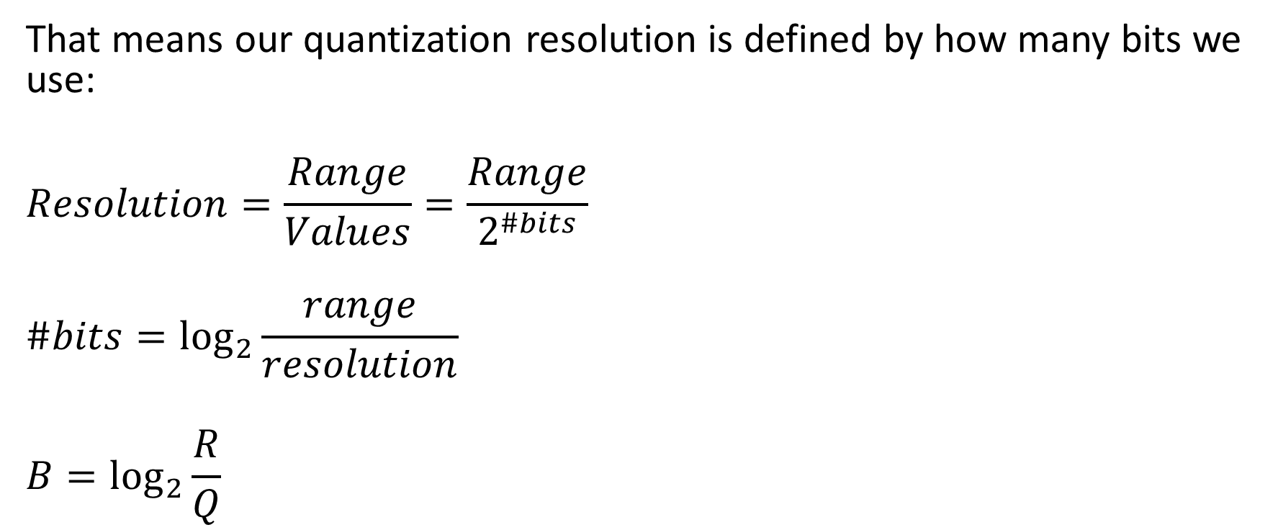
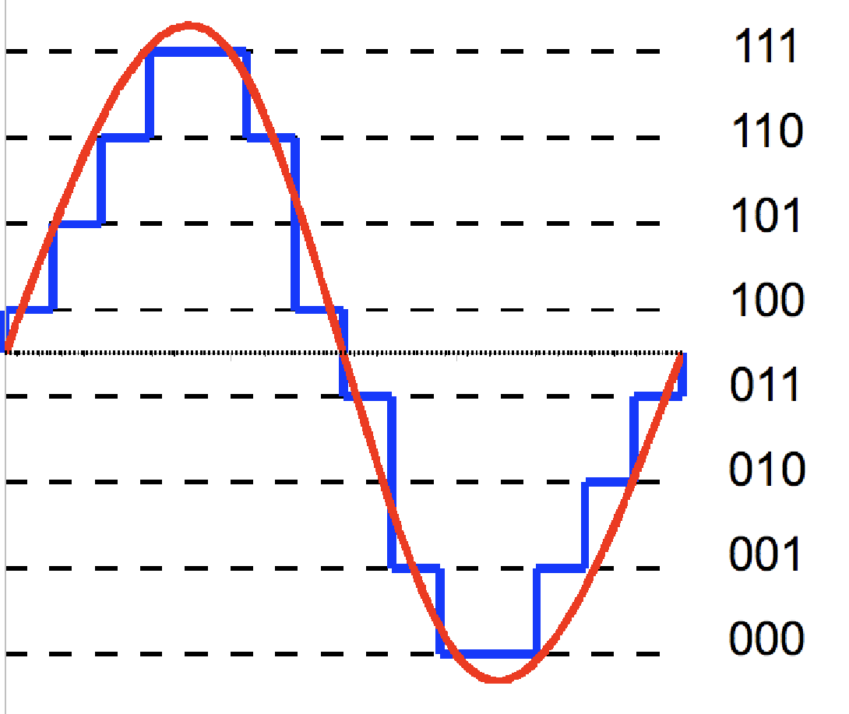
Resolution

Slide 7
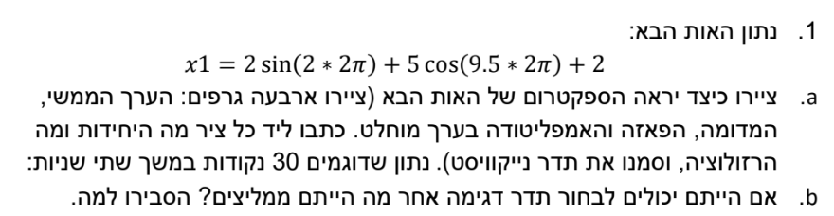

Slide 8
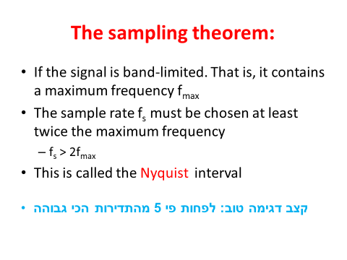
Nyquist frequency
Sample the signal at a frequency higher than 2 times of the maximal frequency in the signal
f_{s} > 2f_{max}

Slide 9
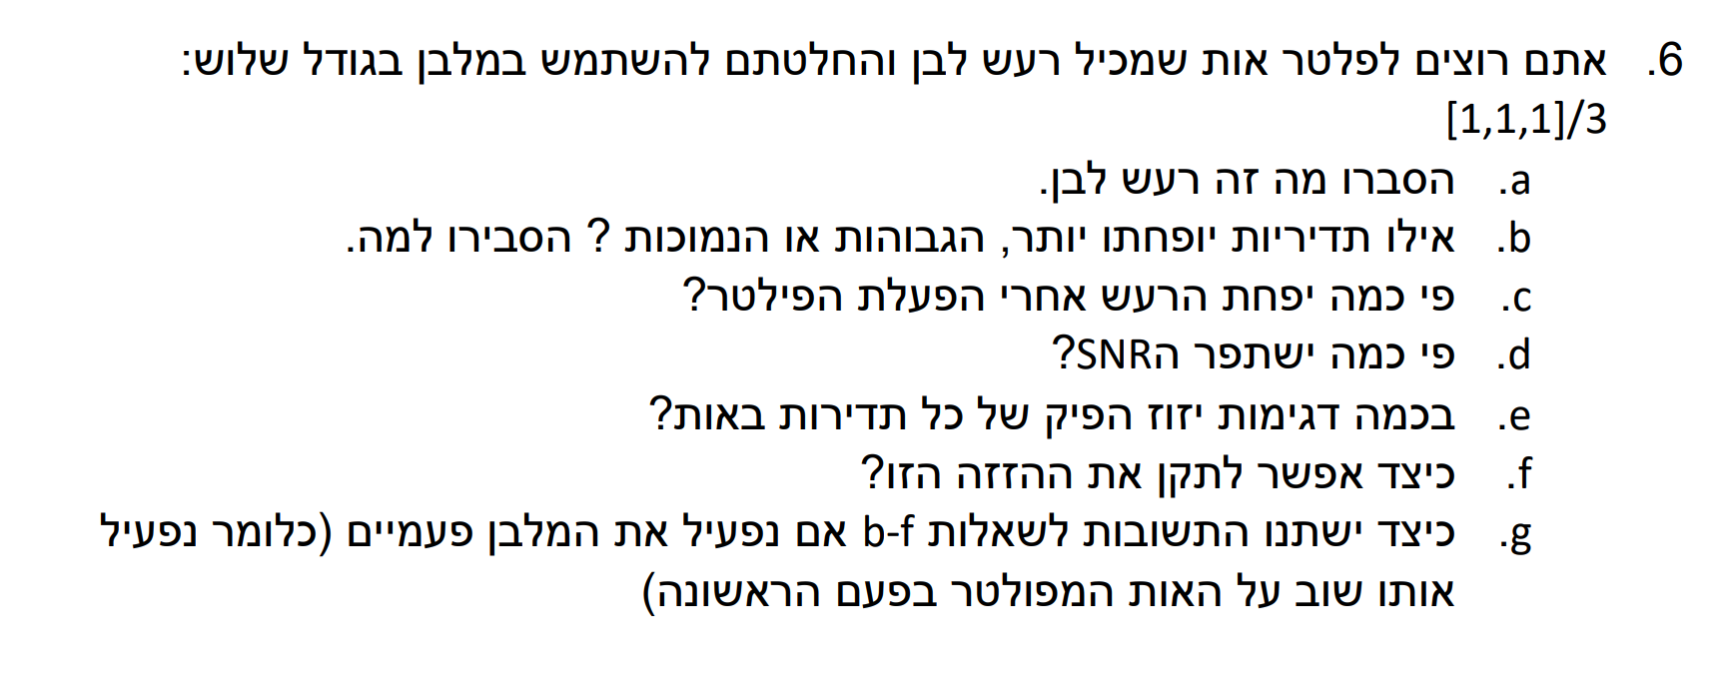

Slide 10
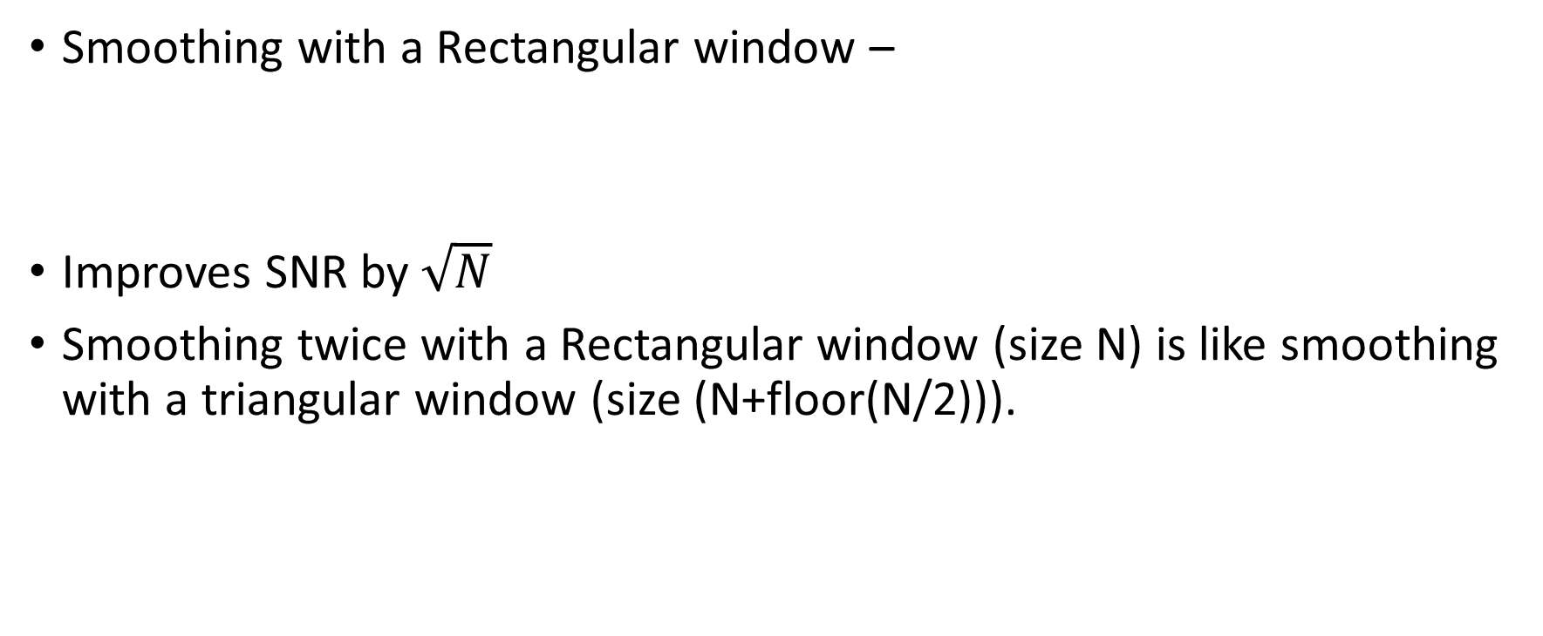
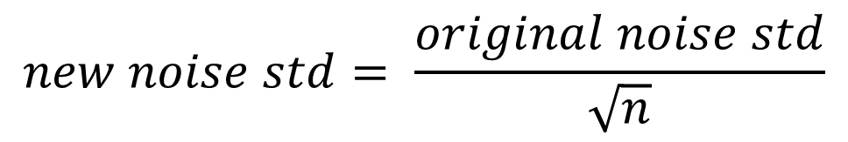
Smoothing – effect on SNR
Same effect on SNR as we got using averaging

Slide 11
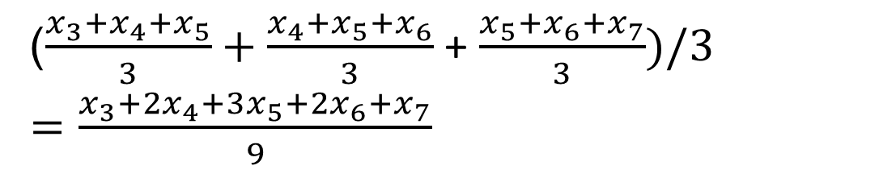
Multiple smooth passes
Smoothing twice with a rectangular is the same as once with a triangular
The general rule: n passes with a rectangular window of size w is the same as one pass with a triangular window of :
n*(w-1)+1
2*(3-1)+1 = 5
X₅ after first pass

Slide 12
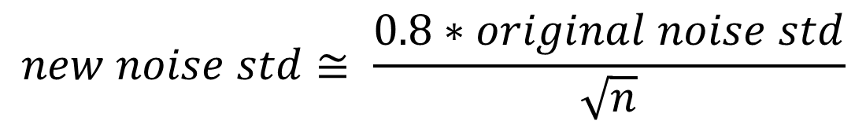
Smoothing – effect on SNR
What is the improvement in the SNR following smoothing with a triangular window?

